Slide 1
2016 Cherokee County Millage Rate
Proposed Scenarios
July 21, 2016

Slide 2



Three Steps To Calculating A Millage Rate
Step #1
Build a Zero-Based Budget for FY2017
Departments Build Proposed Budgets Based on Current Needs
Conduct Budget Review Meetings with the County Manager
Step #2
Forecast All Non-Property Tax Revenues Available to Support ZBB Expenditures in FY2017
Assess Current Run Rates, Incorporate Expected Changes
Step #3
Calculate 2016 Millage Rate Using Latest Tax Digest
ZBB Expenditures – Non Property Tax Revenues = Property Taxes Necessary to Fund Budget

Slide 3
Step #1
Build a Zero-Based Budget for FY2017

Slide 4

General Fund Expenditures
Zero-Based Budget Expenditures (Work-in-Process)

Slide 5
General Fund Expenditures
Zero-Based Budget Variance Explanations
General Services +$319k
Community Services +$235k (Agency being reinstated with zero impact to General Fund budget as a result of reductions in other operations)
Coroner +$66k (New vehicle for transports; more Indigent burials)
Judicial Services +822k
New positions and potential Death penalty case
Healthcare Costs +854k
Increased Medical and Drug claim cost
Increase in Pension Contributions +864k
There has been a change in both the mortality tables and the demographics of our plan that have led to increased required contributions to our plan.

Slide 6
Step #2
Forecast All Non-Property Tax Revenues

Slide 7
General Fund Revenue
Revenue Forecast for FY2017 (Work-in-Process)
Variance Explanations:
Non-Property Taxes:
Intangibles +$300K, Franchise Tax +$150K, Reduction of Motor Vehicle +$133K
TAVT -$215K
Charges for Services:
Commissions on Tax Collections +$80k, Landfill Use Fees +$120K
Fines & Forfeitures:
Probate Court +$65k

Slide 8
Step #3
Calculate 2016 Millage Rate Using
Latest Tax Digest

Slide 9


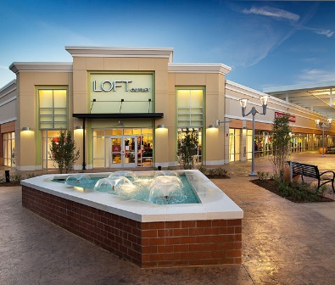
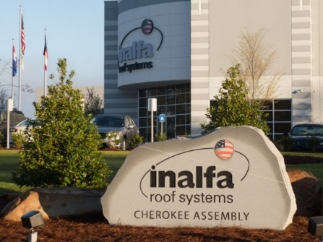
Tax Digest
2016 Experienced Growth
M&O Digest - Assessment Notices (Before Appeals)
From $7.96 Billion to $8.50 Billion – 6.78% Increase
Existing Properties = 3.10%
Other Growth = 3.68%
M&O Digest – Updated End (to be submitted to the State)
From $7.96 Billion to $8.49 Billion – 6.63% Increase
Existing Properties = 3.07%
Other Growth = 3.56%
Notes:
In 2016
We calculate the %’s by looking at the actual beginning and actual end of our digest for the prior year.
Final was 94.84% of first.
New final was 83.78% of the ending.

Slide 10
General Fund Calculating the Millage Rate – Various Scenarios
General Fund Property Tax Rates Lowered each of the past 5 years – from 5.825 in 2012 to 5.715 proposed in 2016

Slide 11
Fire Fund Expenditures
Zero-Based Budget Expenditures (Work-in-Process)
Variance Explanations:
6 new Positions $326K
FAO/Paramedic Increases $170K
Operating increases $56K, WC Claims $64K

Slide 12
Fire Fund Revenue
Revenue Forecast for FY2017 (Work-in-Process)
Variance Explanations:
Non-Property Taxes – TAVT +$110K, Intangibles +$.6K
Charges for Services – Fire Protection fees from Cities +$286K

Slide 13
Fire Fund Calculating the Millage Rate – Various Scenarios

Slide 14
Parks Bond Debt Service
Calculating the Millage Rate
Total Net Costs include repayment of the $500k loan from Unincorporated
County Services Fund needed in FY2015 because of the delayed sale of Dunn tract.
The County completed an advanced refund of the Parks Bond, which resulted in overall
savings of $3.6M to reduce the millage rate by 0.131 mills.

Slide 15

Average Homeowner Impact
Average Home Value $229,300
Current $ Proposal $455k UOR Proposal $750k UOR
Millage Rate Impact Millage Rate Impact Millage Rate Impact
County 5.720 $496.04 5.715 $495.60 5.680 $492.57
Fire 3.436 $315.15 3.430 $314.60 3.374 $309.46
Parks Bond 0.744 $68.24 0.609 $56.22 .609 $55.86
Year Total 9.900 $879.43 9.754 $866.42 9.663 $857.89
-1.48% -2.45%

Slide 16
Breakdown of County M&O
What Services Are Provided for $495.60?
ESTIMATED 2017 BUDGET FOR GENERAL FUND OPERATIONS | TOTAL BUDGET | $ FUNDED BY PROP TAXES | DEPT % OF TOTAL | YOUR TAX DOLLARS GO TO:
General Admin Services | 1,719,006 | 1,181,210 | 2.45% | $12.13
Tax Administration | 4,181,398 | 2,873,234 | 5.95% | $29.50
Health & Human Services | 208,927 | 143,564 | 0.30% | $1.47
Elections | 756,849 | 520,066 | 1.08% | $5.34
Finance & Procurement | 850,560 | 584,459 | 1.21% | $6.00
Information Technology | 2,102,562 | 1,444,769 | 2.99% | $14.83
Libraries | 2,060,074 | 1,415,573 | 2.93% | $14.53
Judicial Services | 14,766,398 | 10,146,682 | 21.02% | $104.18
Law Enforcement | 34,350,921 | 23,604,123 | 48.90% | $242.36
Coroner | 249,287 | 171,296 | 0.35% | $1.76
RRDA Debt Service | 1,101,651 | 756,996 | 1.57% | $7.77
Youth Services & Other Community | 459,473 | 315,726 | 0.65% | $3.24
Property Management | 1,078,739 | 741,252 | 1.54% | $7.61
Transfers to Other Funds: |  |  |  | $0.00
Senior Services | 552,128 | 379,393 | 0.79% | $3.90
Parks and Recreation | 822,855 | 565,422 | 1.17% | $5.81
Transportation | 264,796 | 181,954 | 0.38% | $1.87
Animal Shelter | 462,851 | 318,047 | 0.66% | $3.27
Emergency Medical Services | 1,474,488 | 1,013,190 | 2.10% | $10.40
Economic Development | 45,000 | 30,922 | 0.06% | $0.32
Allocated Costs (WC, Utilities) | 2,735,902 | 1,879,966 | 3.89% | $19.30
TOTAL GENERAL FUND | 70,243,865 | 48,267,843 | 100% | $495.60
70% of County M&O property taxes pays for law enforcement and judicial services
Developing a plan to refinance the 2007A RRDA Bonds in 2017 to a lower interest rate and reduce principle with use of reserves and sale of property

Slide 17
Next Steps
Public Hearing
Tuesday,
July 5
Public Hearing
Tuesday,
July 19
Public Hearing
Thursday,
July 21
Adopt All County Rates Thursday, July 21
Advertise Proposed M&O Rate in Sunday, June 26 Cherokee Tribune

